Slide 1
Food

Slide 2
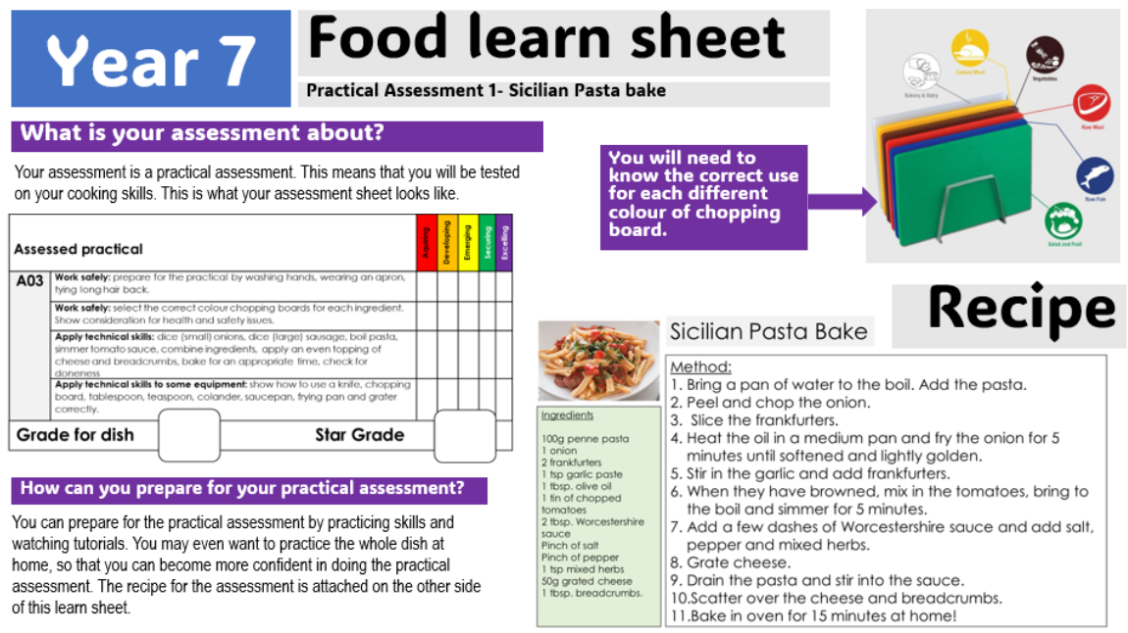

Slide 3
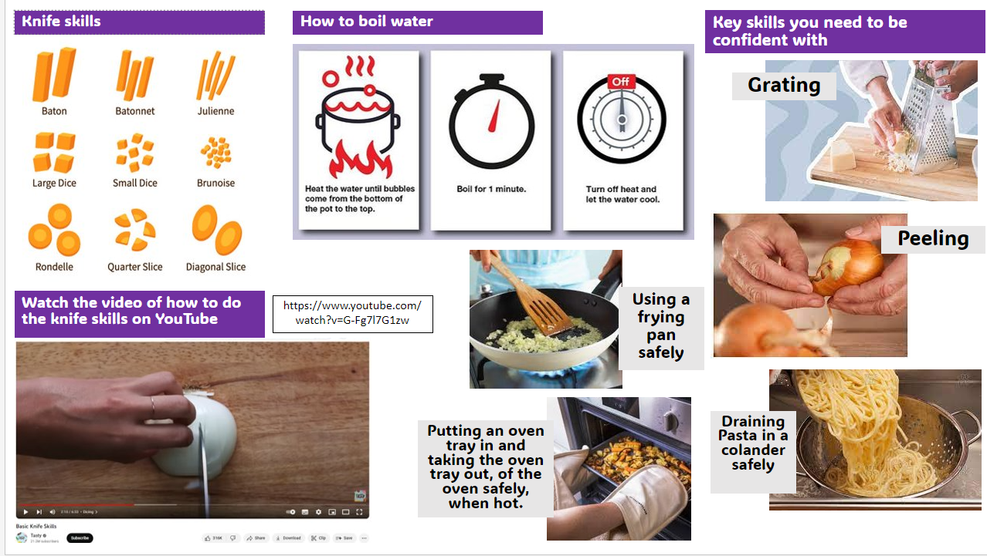

Slide 4
3D

Slide 5
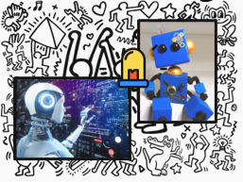
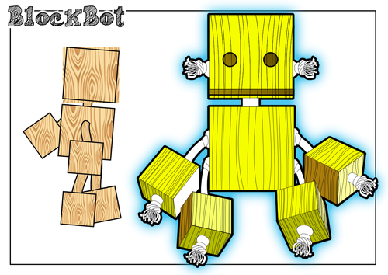
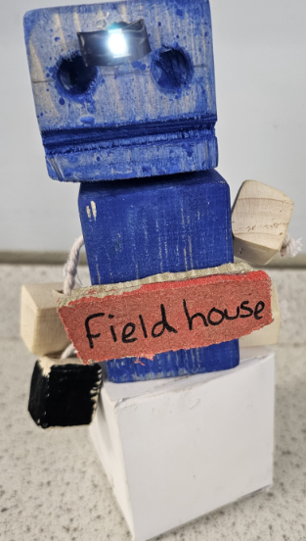
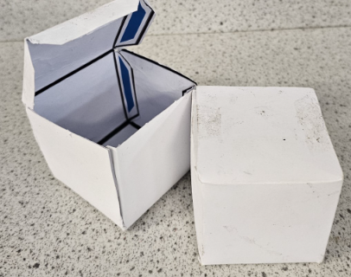
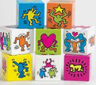
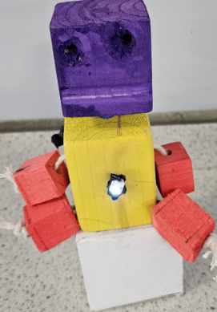
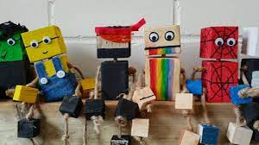
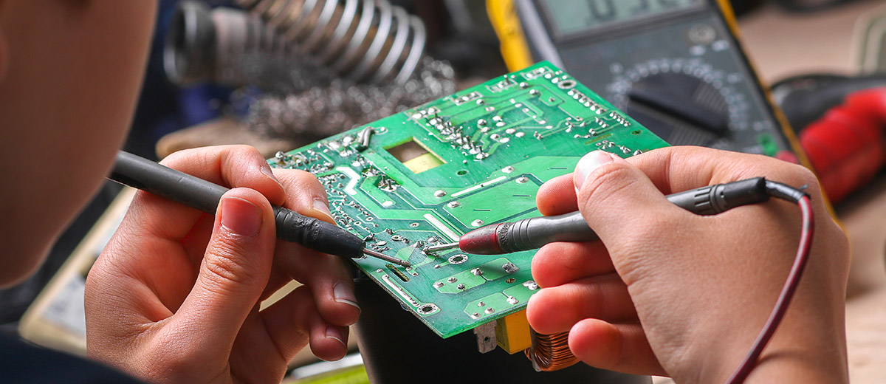
The design brief
Design, Make and Evaluate a robot toy to be sold at Bradford Museum of Film and Photography using robots from science fiction films, as design inspiration.
Investigating the work of others Keith Haring
Electronics

Slide 7
Textiles

Slide 8
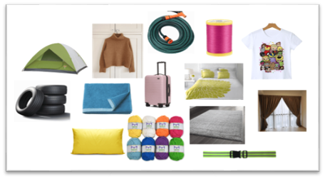
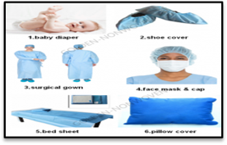
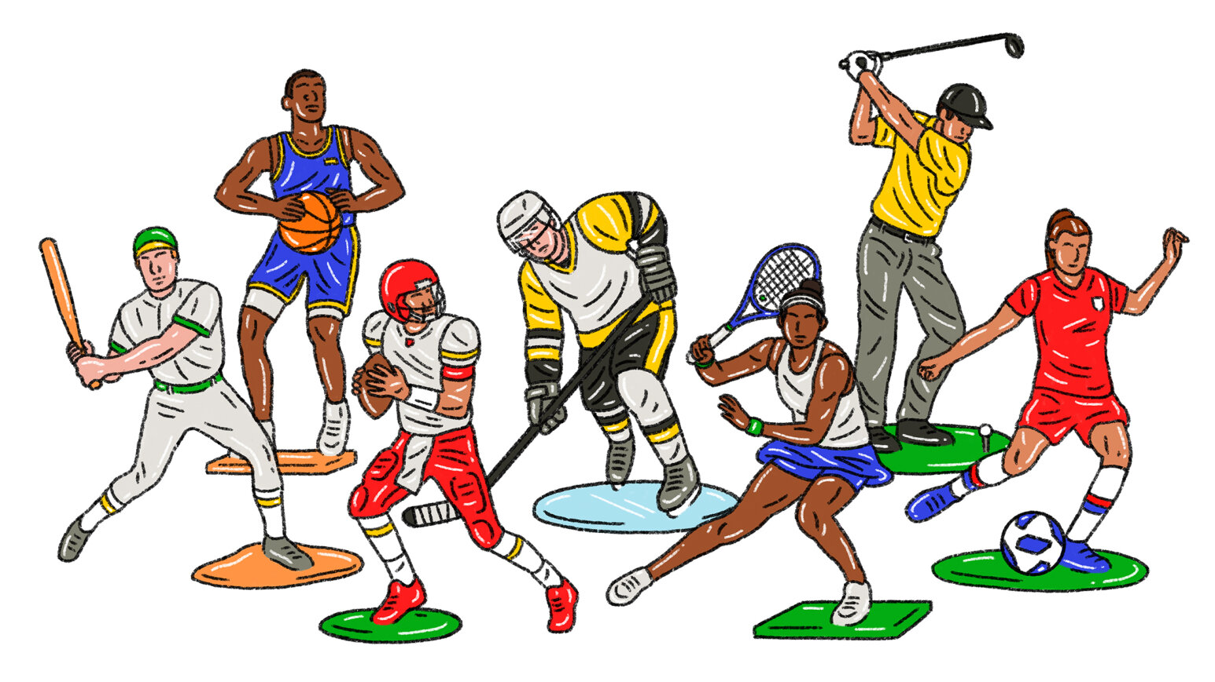
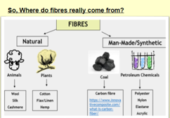
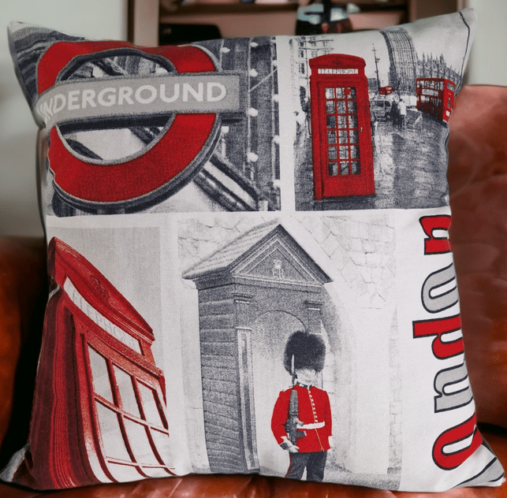
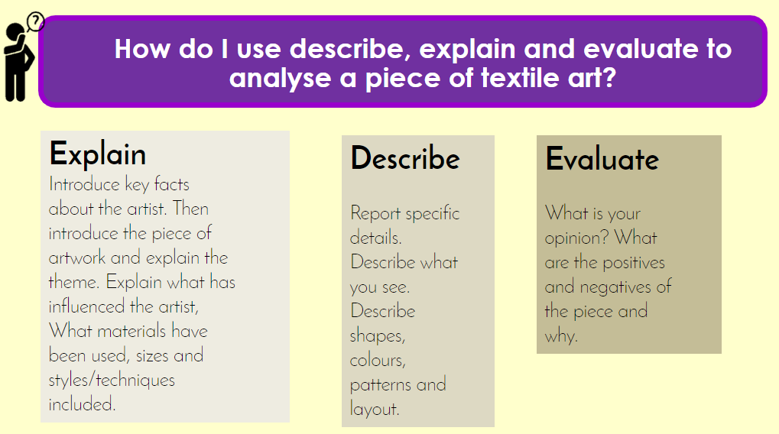
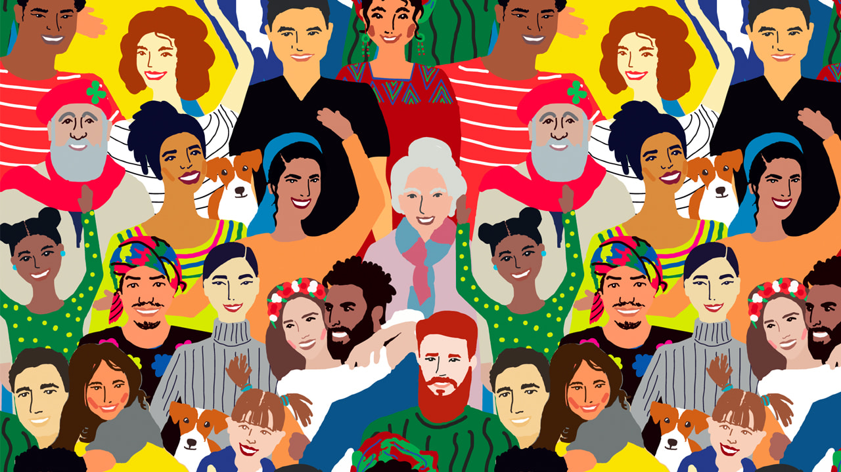
YEAR 7 TEXTILES – LEARN SHEET 1
Understanding uses of textiles in the wider world. And design your own work using ideas collected from research.
What is textiles?
A textile is a flexible material made by creating an interlocking bundle of yarns or threads, which are produced by spinning raw fibers into long and twisted lengths.
Textiles are then formed by weaving, knitting, crocheting, knotting, tatting, felting, bonding, or braiding these yarns together.
What are some of the ways in which textiles has been used around you?
Keywords-
Plant or Cellulose fibres, Animal or Protein fibres, Synthetic or Man-made fibres. Coal, Oil, or Petroleum chemicals,
Inspiration from Cultural Diversity
Design Brief
Celebrating Cultural Diversity
Culture is a key aspect of who we are and what we look for from others. As a designer/artist, you have been asked to explore the theme of diversity of/in culture within textiles.
Design, make and evaluate a printed cushion that is inspired from the experimentation tasks you have carried out. This cushion must be suitable for a room in your home.
The arts and other manifestations of human intellectual achievement regarded collectively.
"20th century popular culture"- Punk
The ideas, customs, and social behaviour of a particular people or society. 'British, Asian, Polish, African, etc.
Explain
Introduce key facts about the artist. Then introduce the piece of artwork and explain the theme.
Explain what has influenced the artist, What materials have been used, sizes and styles/techniques included.
Describe
Report specific details. Describe what you see. Describe shapes, colours, patterns and layout.
Evaluate
What is your opinion? What are the positives and negatives of the piece and why

Slide 9
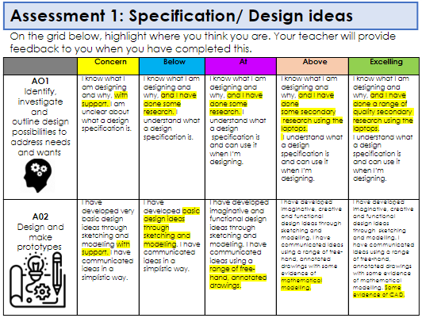
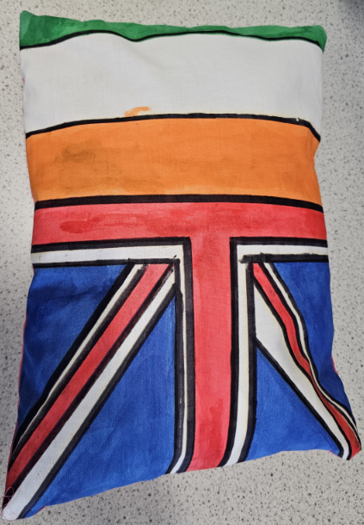
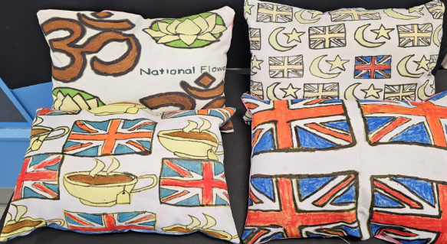
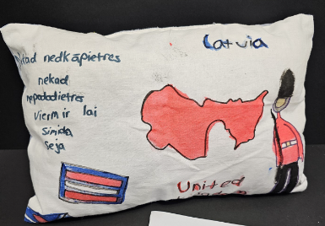
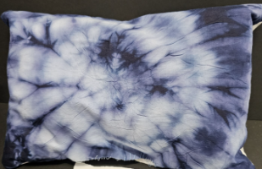
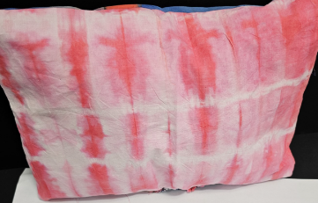
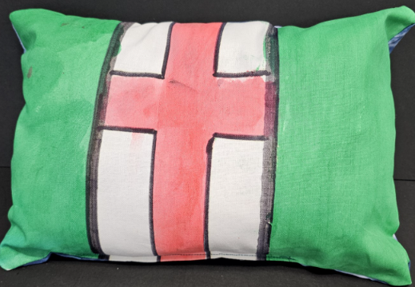
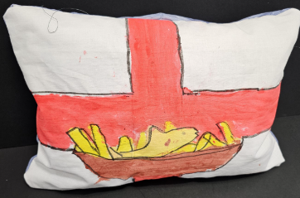
YEAR 7 TEXTILES – LEARN SHEET2
Recreating the work of your artist, using your own ideas from your portrait
Success criteria
You must design and make a cushion based on a culture of your choice.
W
A
G
O
L
L
To prepare yourself for the assessment, look at the examples of work by others below and practice your creative idea in the box below, then get ready to succeed in class. You can combine cultures as seen in one below. Can you spot one?

