Slide 1
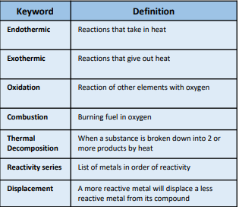
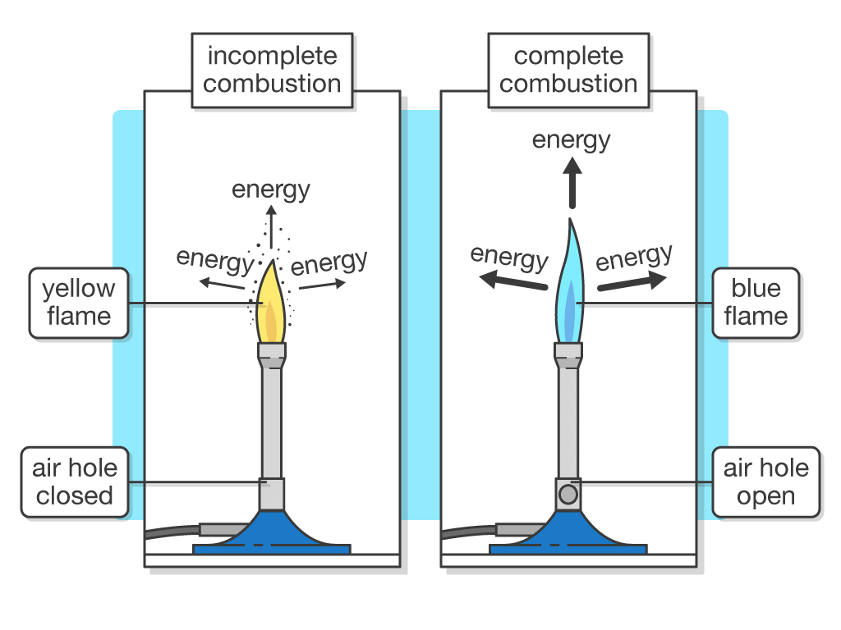
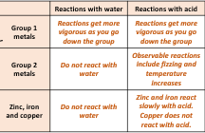
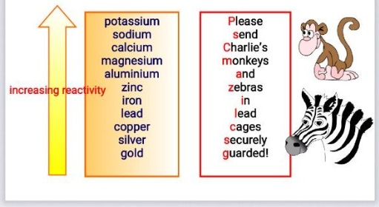
Unit 8.2 Chemical reactions
KO

Slide 2
 | Summary Questions | Answers
1 | What is an exothermic reaction?
2 | What is an endothermic reaction?
3 | What is a displacement reaction?
4 | What is the reactivity series?
5 | What is meant by thermal decomposition?
6 | What is combustion?
7 | Give an example of an exothermic reaction?
8 | Give an example of an endothermic reaction?
9 | What colour flame do you see in complete combustion?
10 | What colour flame would you see in incomplete combustion?
11 | What is the most reactive metal in the reactivity series?
12 | What is the least reactive metal in the reactivity series?
13 | As you go down group 1 the metals get mor or less reactive?
14 | Does copper react with water?
15 | When an acid reacts with an alkali you get what two products?
16 | When a metal reacts with acid what gas is given off?
17 | How can you expect to see during a chemical reaction?
18 | What products do you get when a metal oxide reacts with an acid?
19 | What gas is given off when a metal carbonate reacts with acid?
20 | If we tried to react copper carbonate with magnesium would you expect to see a reaction? Why?

