Slide 1
Food

Slide 2
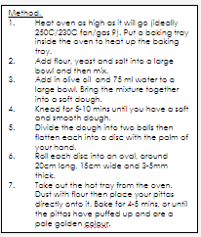
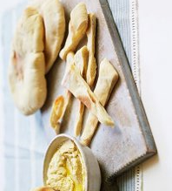
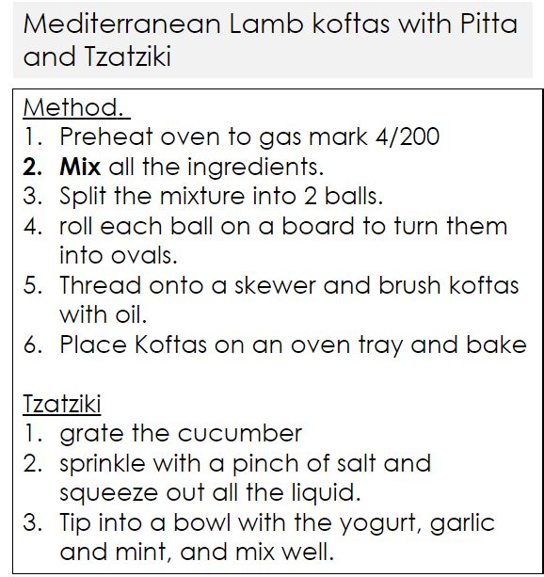
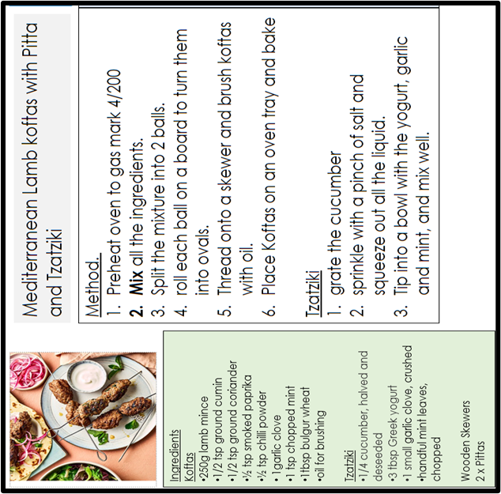
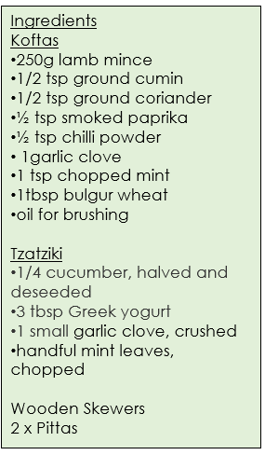
Ingredients
1 tsp fast-action dried yeast
125g strong white bread flour, plus extra for dusting
2 tsp salt
1 tbsp olive oil
Method. Heat oven as high as it will go (ideally 250C/230C fan/gas 9). Put a baking tray inside the oven to heat up the baking tray. Add flour, yeast and salt into a large bowl and then mix. Add in olive oil and 75 ml water to a large bowl. Bring the mixture together into a soft dough. Knead for 5-10 mins until you have a soft and smooth dough. Divide the dough into two balls then flatten each into a disc with the palm of your hand. Roll each disc into an oval, around 20cm long, 15cm wide and 3-5mm thick. Take out the hot tray from the oven. Dust with flour then place your pittas directly onto it. Bake for 4-5 mins, or until the pittas have puffed up and are a pale golden colour.
Mediterranean Lamb koftas with Pitta and Tzatziki​

Slide 3
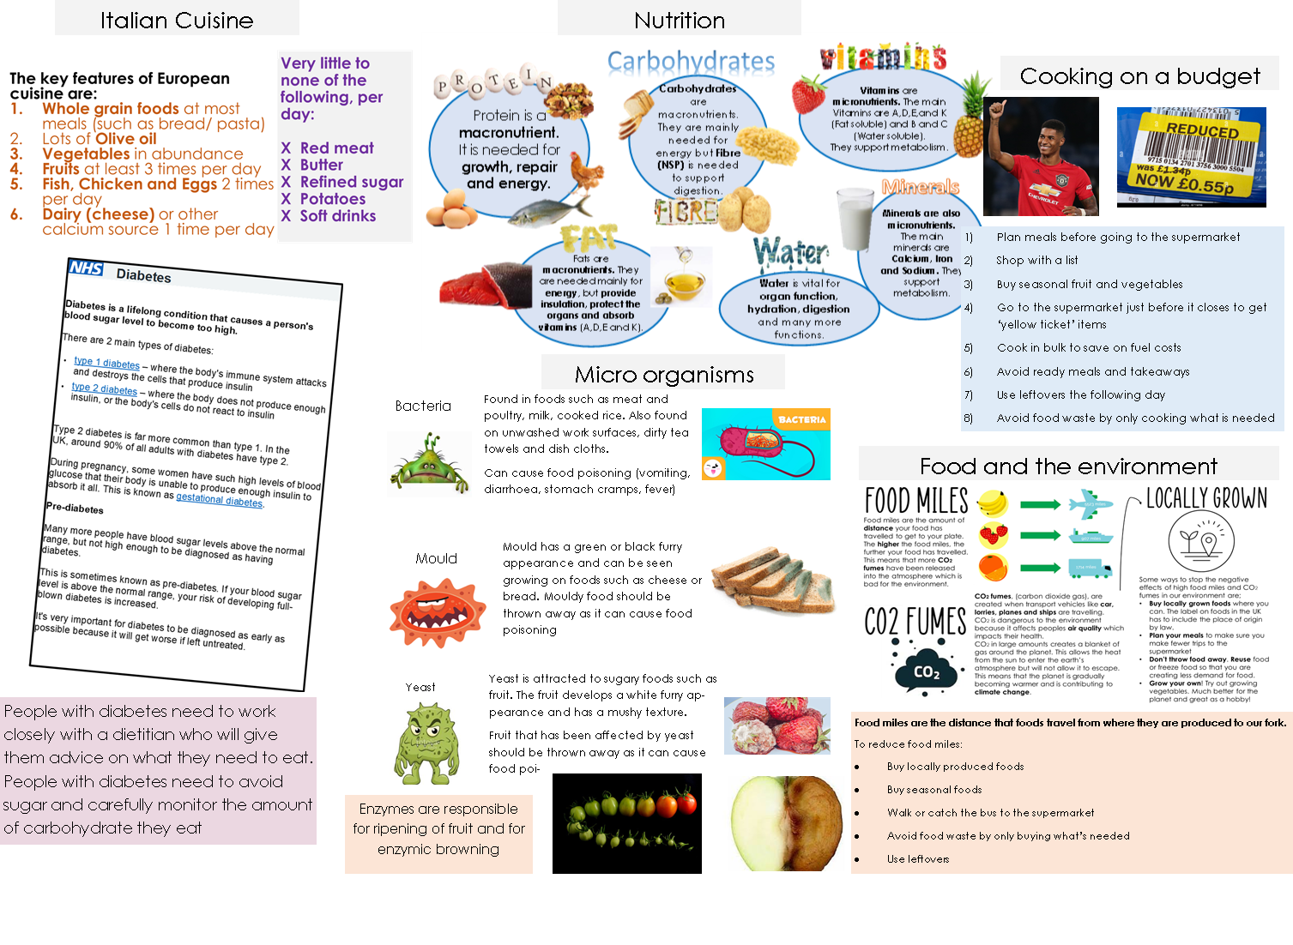
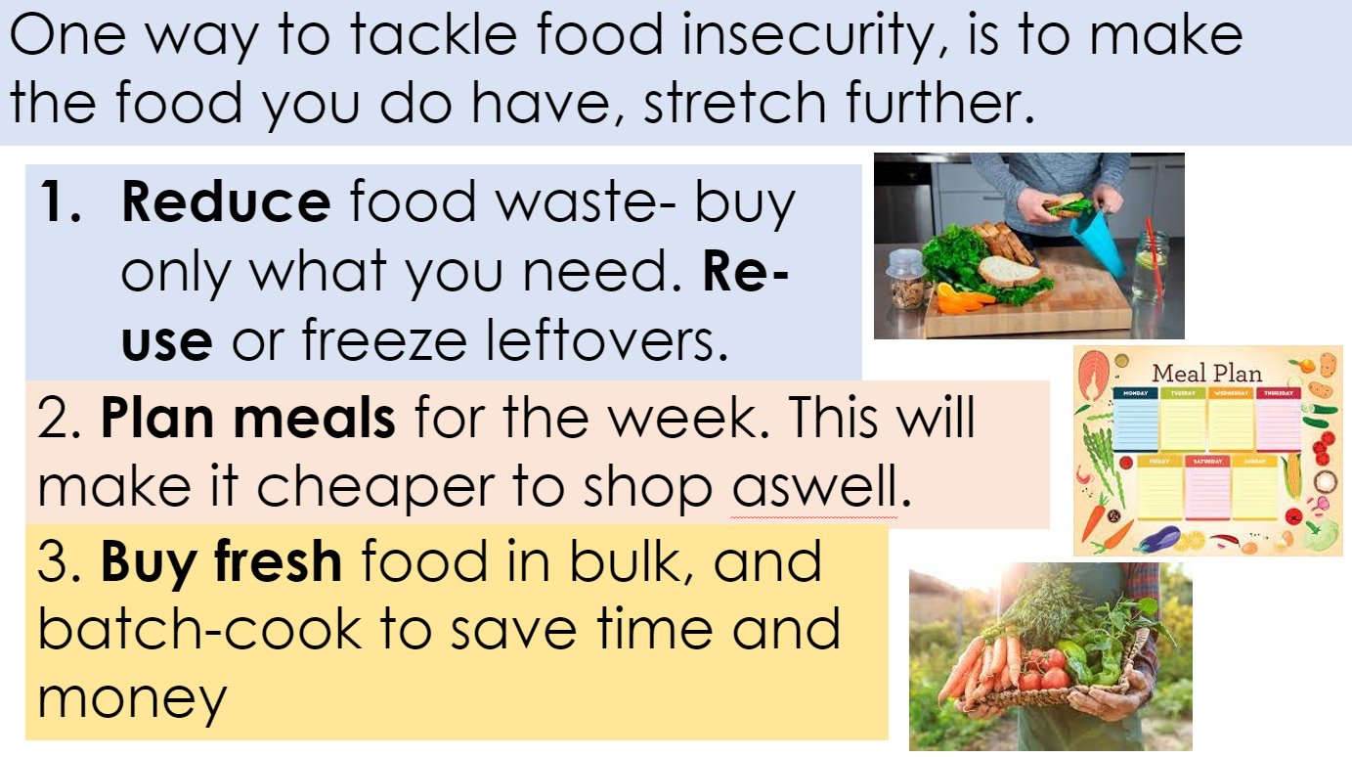

Slide 4
3D

Slide 5
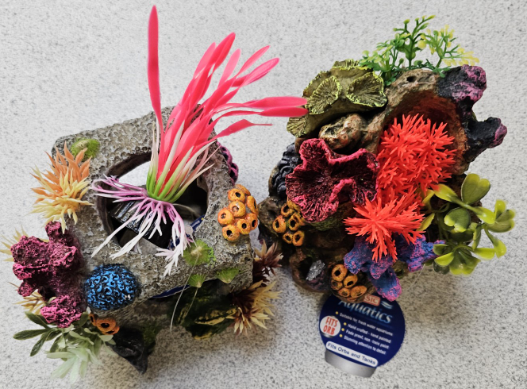
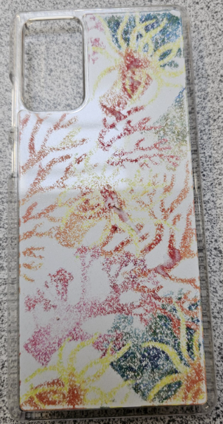
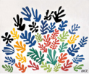
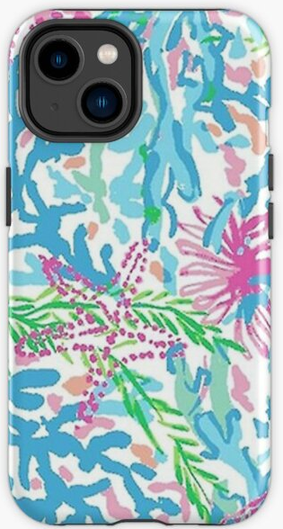
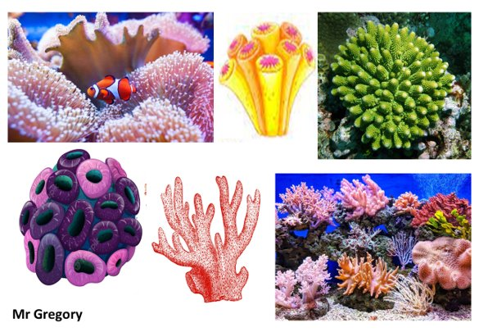
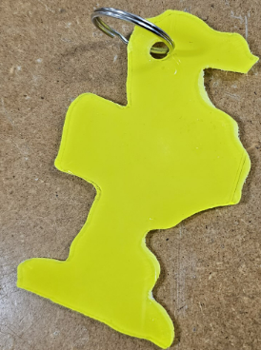
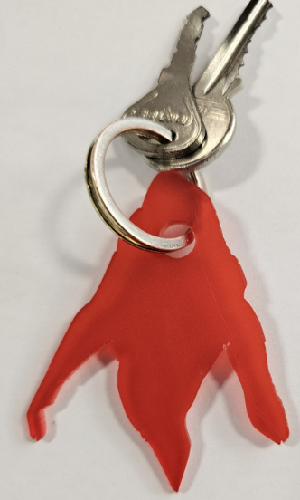
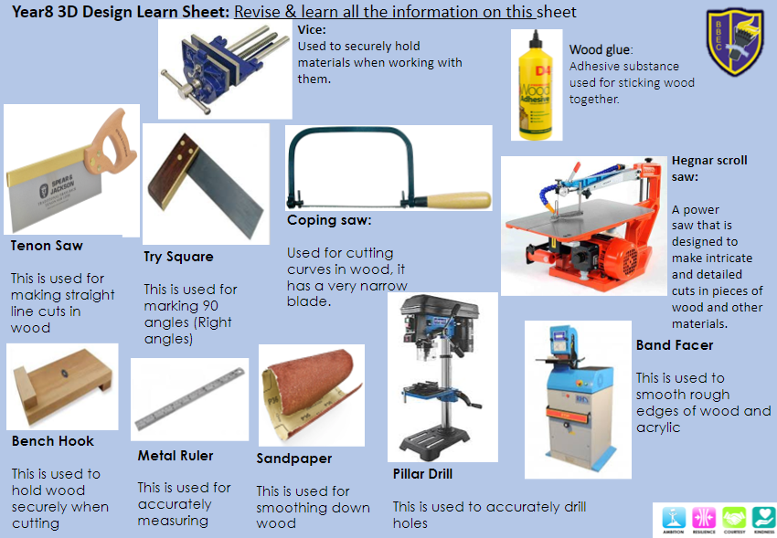
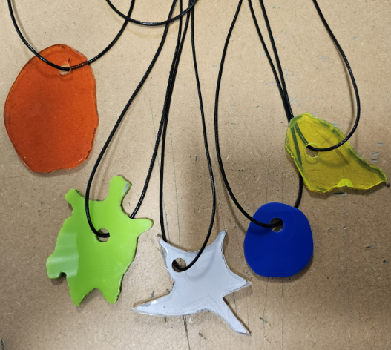
Investigating the work of others Henri Matisse
WWF
https://www.worldwildlife.org/pages/everything-you-need-to-know-about-coral-bleaching-and-how-we-can-stop-it
Barrier reef organisation
https://www.barrierreef.org/the-reef/threats/coral-bleaching
The design brief (2)
Make a Sealife themed keyring/pendent to be sold on the Ocean Conservation Trust (OCT) website.

Slide 6
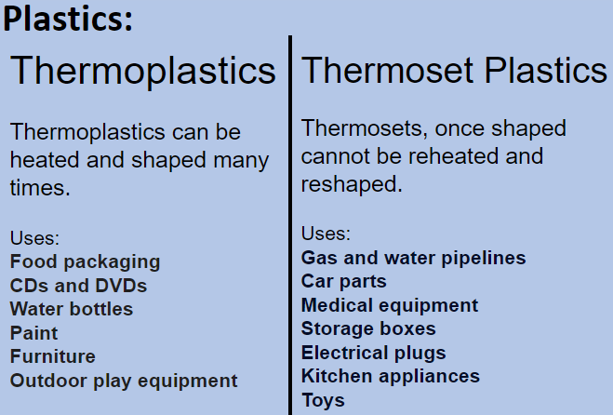
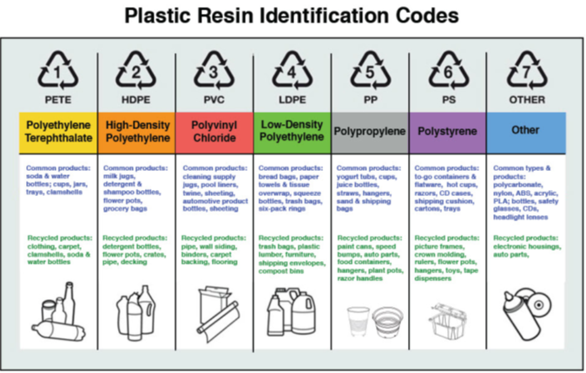
Material Science: Plastics
Key words:
Synthetic: A material made by joining chemicals together, it is manmade product
Atoms: The basic building block for all the things in the universe. Atoms are extremely small.
Molecules: Groups of two or more atoms.
Thermoplastics: Plastics that can be heated and shaped many times.
Thermoset plastics: Plastics that once shaped cannot be reheated and reshaped.
What is plastic and what is it made from?
Plastic is a synthetic material, which is manmade. Most plastics are made from chemicals, which are found in oil.
Heating these chemicals causes them to break down into molecules. Scientists then join these molecules into chains to form plastics.

Slide 7
Textiles

Slide 8
YEAR 8 – LEARN SHEET
Revise the notes on this page for your knowledge on fabrics.
Fabric Construction-
Success criteria
Fabric structures
WORDS TO USE
strong | one | stretchy | stiff | spinning | weft
loom | weak | two | selvedge | yarns | break
 | Woven Woven fabrics are ……………… and stable. They are made on a ……………… Usually, woven fabrics are made using ……………… yarns; the warp and ……………… Woven fabrics have a ………………
 | Knitted Knitted fabrics are ………………. They are made from ……………… yarn. The yarns can catch and ………………, which is when all the loops that join together cause knitted fabrics to ladder.
 | Non-Woven Non-woven fabrics are ………………. They are usually thick and ……………… and cannot be washed. Non-woven fabrics are NOT made from ……………… which makes them cheaper to produce.
What is the definition of a fabric?
Fabric is cloth or other material produced by weaving together cotton, nylon, wool, silk, or other threads. Fabrics are used for making things such as clothes, curtains, and sheets.
FABRICS
Woven
Knitted
Non-woven
Calico/Cotton
Jersey
Give me examples of products:
Fleece
Jersey
Give me examples of products:
Wadding
Interface
Give me examples of products:
Product | Fabric
Jeans | Denim
Towel | Toweling
School Shirt | Polycotton
Product | Fabric
T-Shirt | Jersey
Hoodie | Fleece
Skins | Lycra
Product | Fabric
Quilt | Polyester wadding
Soft toys | Felt
Storage box | Bonded

Slide 9
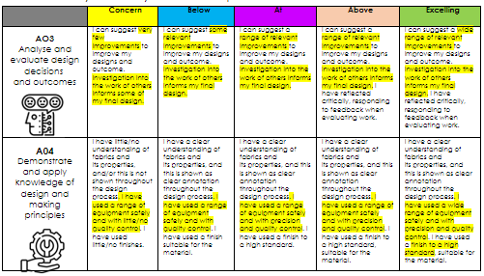
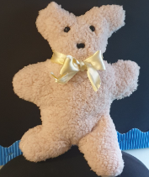
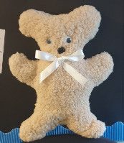
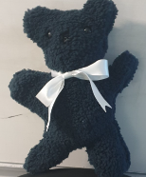
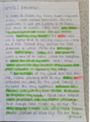
YEAR 8 – LEARN SHEET
Recreating the work of your artist, using your own ideas from nature
The design brief
Inspiration from Margarete Steiff
‘We cannot walk alone’- Teddy for healing
Each year, we welcome thousands of refugees/asylum seekers into our country; which makes people see Britain as a safe and kind place to go to, when fleeing persecution or war.
You have been asked to explore the theme of belonging. Design, make and evaluate a cuddly teddy that can be given to a child who has just arrived in the UK, to welcome them to their new home.
Success criteria
W
A
G
O
L
L
To prepare yourself for the assessment, look at the examples of work by others below and practice your creative idea in the box below, then get ready to succeed in class. You can make up your own features with fabrics, it hand embroidery stitches.
Using extended
writing skills in Technology

