Slide 1
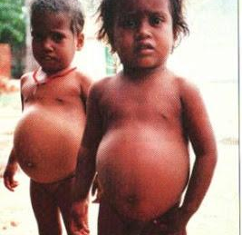
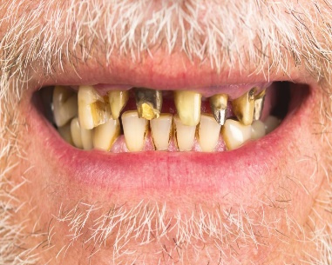
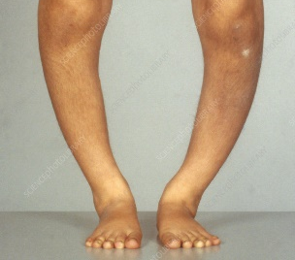
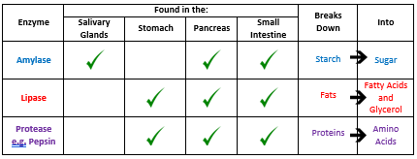
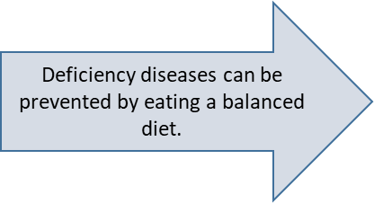
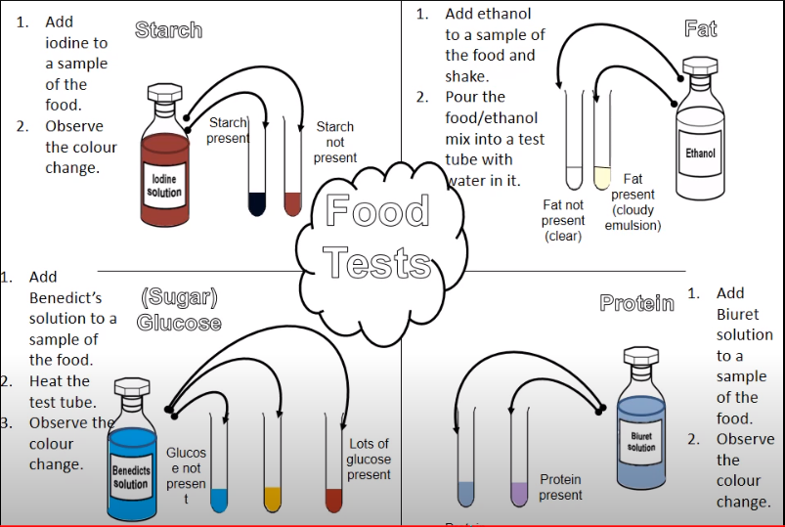
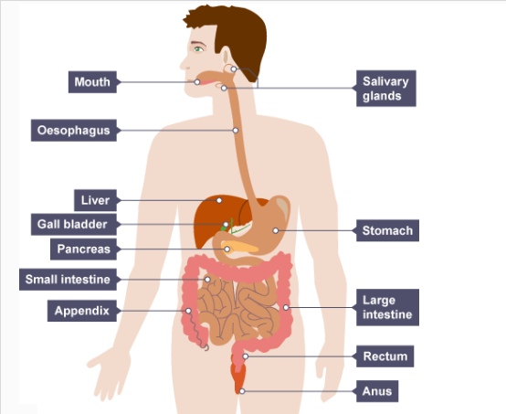
Nutrition, Health & Disease: Knowledge Organiser
Balanced Diet | A diet consisting of lots of different food groups which provides all nutrients needed for good health.
Starch | Sugar (glucose) gets stored as starch in plants, so it can be used for energy at a later time.
Deficiency Disease | A deficiency disease is when a person is severely lacking a certain nutrient in their diet.
Kwashiorkor | Caused by a lack of protein. Severe malnutrition, causes swelling because of built up body tissues, usually in the belly.
Night blindness | Caused by lack of vitamin A. Struggle to see in low light levels. Can lead to permanent blindness if not treated.
Scurvy | Caused by a lack of vitamin C. Causes bleeding teeth and gums, tooth loss and joint pain.
Rickets. | Caused by a lack of vitamin D. Affects bone development in children. Bone becomes soft and weak and can show deformities, such as bowed legs.
Risk Factor | Something that causes someone to be more likely to develop a disease. E.g. Smoking is a risk factor for lung cancer.
Cancer | A disease caused by rapid uncontrollable cell division, caused by a mutation (change) in DNA.
KWASHIORKOR
SCURVY
RICKETS
Unit 8.2 Nutrition health & disease KO

Slide 2
 | Summary Questions | Answers
1 | What is glucose stored as in plants?
2 | Define ‘deficiency disease’, give an example & state what vitamin deficiency it is caused by.
3 | Give a risk factor for lung cancer
4 | Name a disease caused by excessive drinking of alcohol
5 | How can you test how much sugar is in a sample of food? Name the chemical used, and the changes involved.
6 | How can you test if a sample of food has starch in it? Name the chemical used, and the changes involved.
7 | How can you test if a sample of food has protein in it? Name the chemical used, and the changes involved.
8 | How can you test if a sample of food has fat in it? Name the chemical used, and the changes involved.
9 | What is a balanced diet?
10 | Where is amylase found in the body?
11 | . Where is protease found inside the body?
12 | Where is lipase found inside the body?
13 | Which organ produces bile?
14 | Protein are broken down in to what?
15 | Fats are broken down in to what?
16 | Starch is broken down into what?
17 | Which part of the digestive system is the food absorbed in to the blood?
18 | What is the role of the large intestine?
19 | Where in the body does digestion of food start?
20 | Which disease is caused by a lack of vitamin D?

